Slide 1
Traffic View Tool & Feed Bootcamp
with Elad Saban, Waze Product Specialist

Slide 2
Agenda
Waze for Cities news: Crisis drills. First one with the City of Auburn AL.
New educational modules in the portal:
Using Traffic View
Submitting Traffic Events
Marketing and Comms
Traffic View Tool & Feed basics - Elad Saban, a Waze Partnerships technical expert
Traffic View Q&A

Slide 3
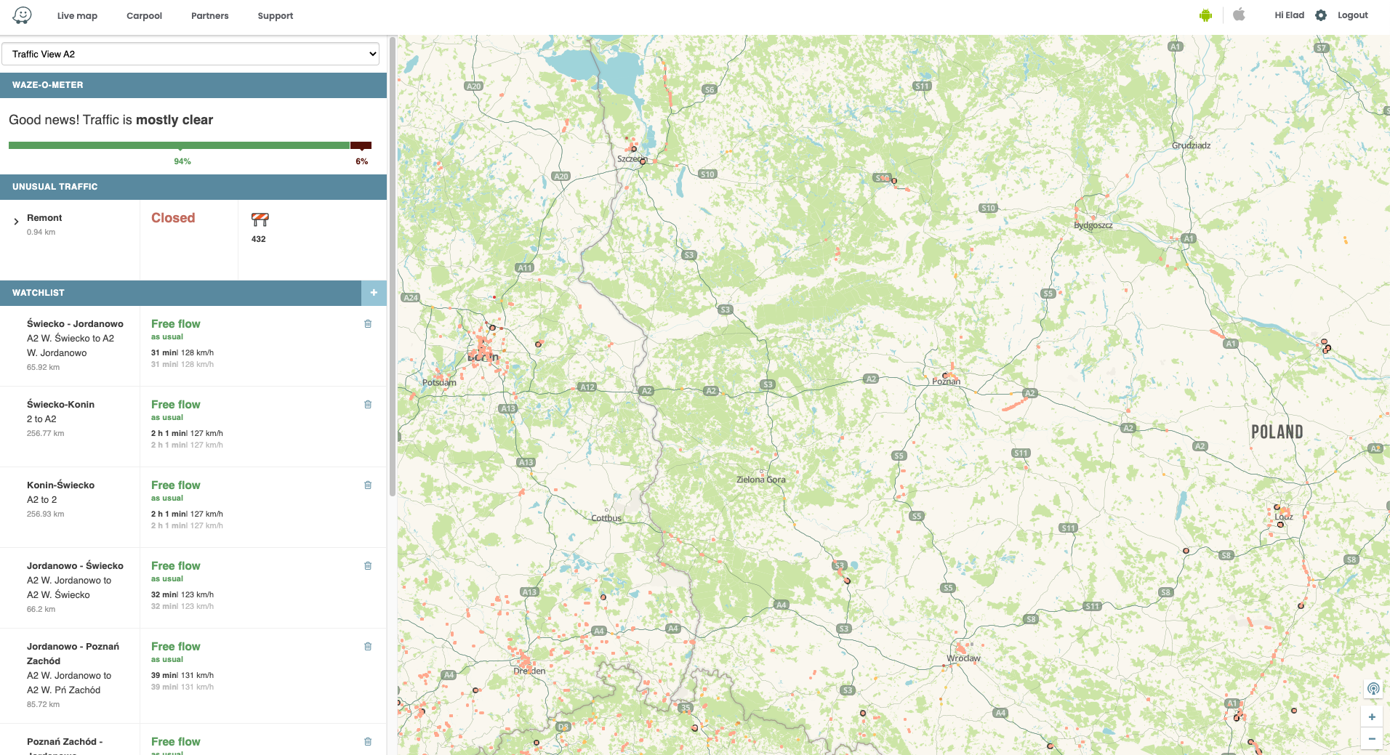
Traffic View Tool
What: A real-time monitoring dashboard that allows Waze partners to see traffic in their area 24/7.
The tool compares historical and live traffic data and consolidates traffic conditions into a “Waze-o-meter”.

Slide 4
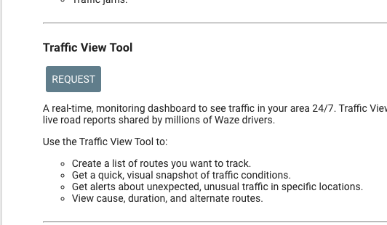
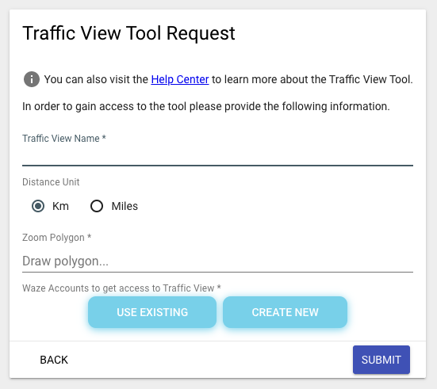
Request access to the Traffic View tool
Sign in to the portal and open the Share Data with Waze section.
Scroll down and click on the request button under the Traffic view tool
Fill in the form with the new Traffic view details or edit an existing request to add additional users to this specific tool and click submit
Once ready to use, an email will be sent to the Portal account owner and the status of the request will be changed to Live

Slide 5
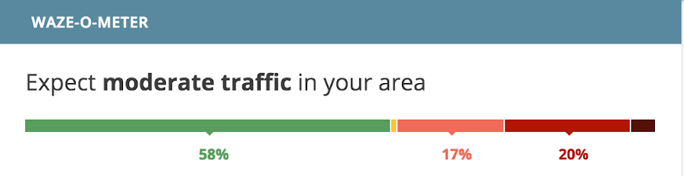
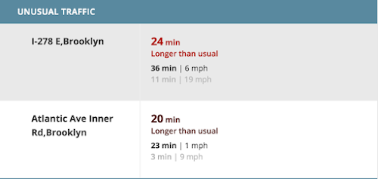
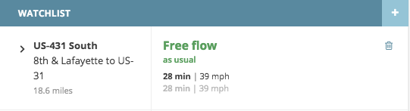
Use the Traffic view tool
Use the Watchlist to save routes that you want to track frequently.
Black - the current amount of time it will take to complete the route
Grey - The amount of time it normally takes to complete the route (based on historical traffic data, Waze calculates the average ETA for the route at a specific time and day of the week).
To add a route:
Click on the + button.
Give your route a name in the Route name field.
Zoom in on the map to find your start and end locations and click to drop the pins on the map.
Click Save and your route should appear on your Watchlist.
The Unusual Traffic feed provides automatic alerts for places where drive times are much longer than expected
.
It provides a link to the best alternate route when available
The Waze-o-Meter provides a quick visual snapshot of the traffic in your area. Click any of the color bars to highlight affected sections on the Livemap:
Green: Free Flow - Great conditions, cars are able to move at speed limit.
Yellow: Light Traffic - Slight congestion, but drivers can still travel at relative speeds.
Light red: Moderate Traffic - Congestion starting to build up noticeably.
Red: Heavy Traffic - Speeds have slowed down, expect significant delays.
Dark red: Bumper to Bumper - Traffic is near standstill.

Slide 6
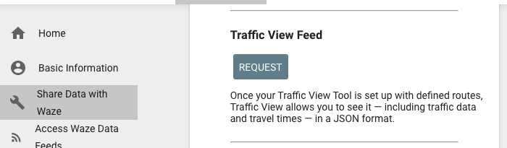
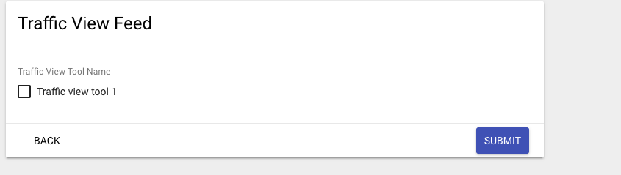
Request a Traffic View feed
Sign in to the portal and open the Share Data with Waze section.
Scroll down and click on the request button under the Traffic view feed
Check the box of the Traffic view tool you want to get a feed for and click submit
Once ready to use, an email will be sent to the Portal account owner and the status of the request will be changed to Live.

Slide 7
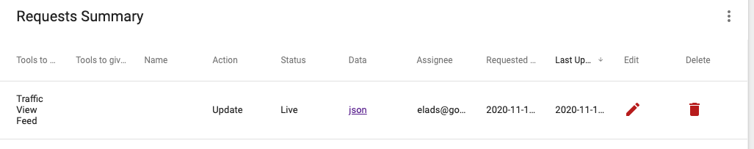
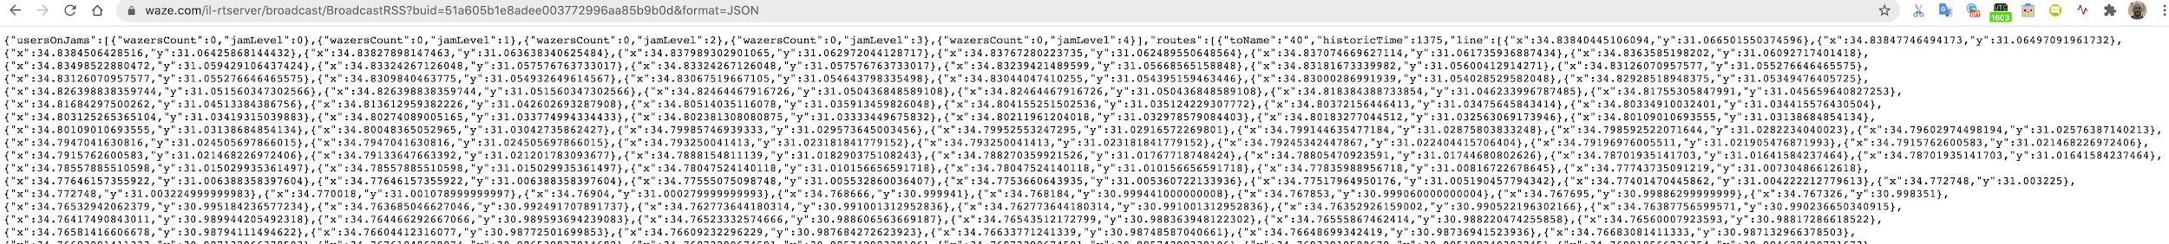
Use the Traffic view Feed
Click on the json link to see your Traffic view feed in the Request Summey table under "Share Data with Waze".
Once the feed is ready to use, an email will be sent with the direct link to the feed and a PDF with the feed specification.
The specification can also be found under the Resources section in the portal.

Slide 8
What can you do with this Data?
Get raw data about your TVT watchlist routes:
Traveling time for each route
Route length
Jam level for each route
An alternate route
Use data to analyse the route and make data informed infrastructure decisions
Use data to create automatic scenarios such as:
Alert first responders to crashes
Alert traffic center when congestion is above a certain level

Slide 9
Thanks!

